Slide 1

UNIT-1 INTRODUCTION
ENGINEERING MATERIALS AND METALLURGY
(MPMEC02)

Slide 2
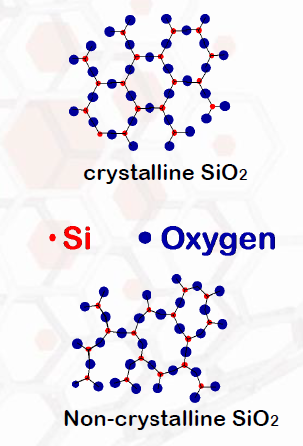
MATERIALS AND PACKING
The materials classified into two categories:
Amorphous materials/Non-crystalline materials
The atoms are ”randomly” distributed in space.
Not quite true, there is short range order.
Complex structures
Rapid cooling
Examples: Glass, polystyrene etc.
Crystalline materials
The atoms are ordered
Short range and long range order
Deviations from the perfect order are of importance for the properties of the materials.
Examples: Metals, some ceramics and polymers etc.

Slide 3
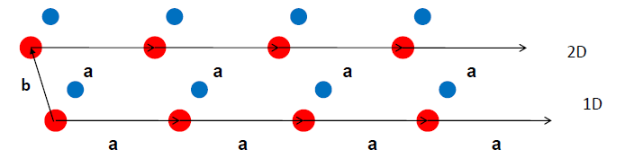
Introduction to crystallography
Crystallography describes and characterize the structure of crystals.
Basic concept is symmetry
Translational symmetry: if you are standing at one point in a crystal, and move a distance (vector) a the crystal will look exactly the same as where you started.

Slide 4
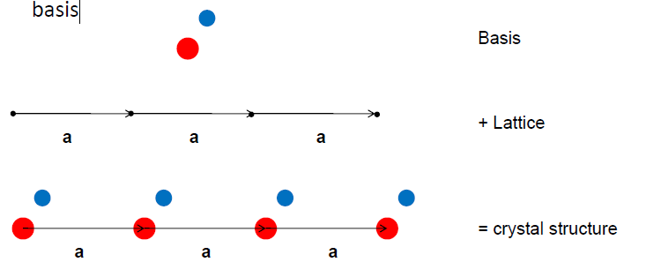
The lattice
A periodic pattern of points in space, such that each lattice point has identical surroundings.
Each of these points represents one or a group of atoms, basis.

Slide 5
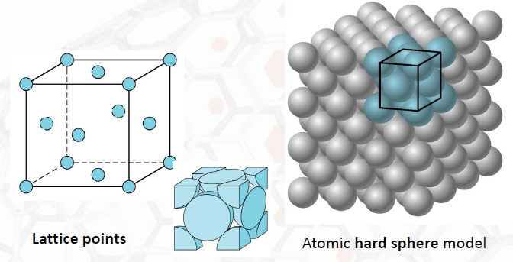
Unit Cell
Unit cell is the smallest unit of volume that permits identical cells to be stacked together to fill all space.
By repeating the pattern of the unit cell over and over in all directions, the entire crystal lattice can be constructed.

Slide 6
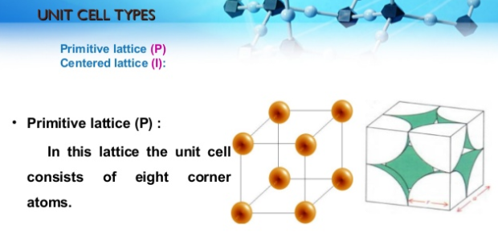

Slide 7
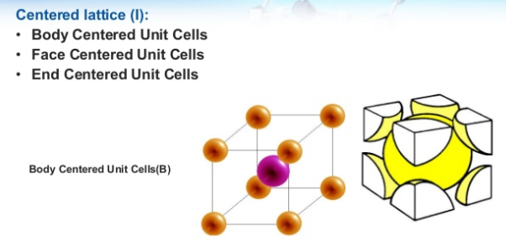

Slide 8
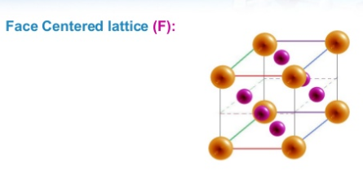
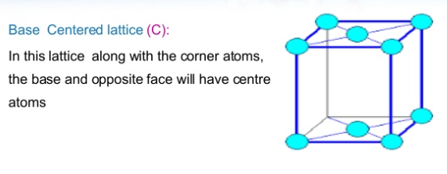

Slide 11
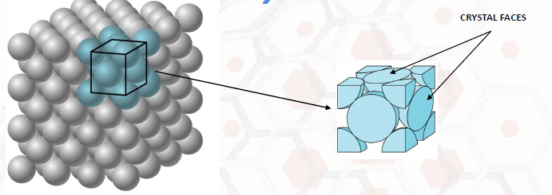
Crystal
A CRYSTAL is any solid material in which the component atoms are arranged in a definite patter and whose surface regularity reflects its internal symmetry.

Slide 12
Crystal Systems
Goal is to Quantitatively Describe
(a) Shape and Size of the Unit Cell (point symmetry).
(b) Location of the Lattice Points (translational symmetry).
What we will do ?
For (a) to specify the Crystal System and the Lattice Parameters.
For (b) to define the “Bravais” Lattice.

Slide 13
Translational Symmetry
Space Group includes two main types of symmetries (i.e. symmetry operations) (I) The Translational Symmetries, and (II) The Point Symmetries
Translations, i.e. executable shifting movements, proceeding along a straight line and on a certain specified distance, such that the operation does not result in any change of the shifted pattern.
Typically the translational symmetries are macroscopically not visible because the translation lengths are in the order of Å.

Slide 14
Point Symmetries
It is a macroscopically visible symmetry operations: after it has been applied to the crystal at least one point remains where it was !!
These operations are :
Reflection in a point (inversion) – Center of Symmetry!
Reflection in a plane or Mirror Symmetry !
Rotation about an imaginary axis –Rotational Symmetry!
Rotation-and-after-it-inversion or Roto-inversion!

Slide 15
The Crystal Systems
In turn these symmetry classes, because some of them show similarities among each other, are divided among the different Crystal Systems.
There are six Crystal System
1. The CUBIC (also called Isometric system)
2. The TETRAGONAL system
3. The HEXAGONAL system
4. The ORTHORHOMBIC system
5. The MONOCLINIC system
6. The TRICLINIC system
Every Crystal System involves a number of Crystal Classes.
Decreasing symmetry

Slide 16
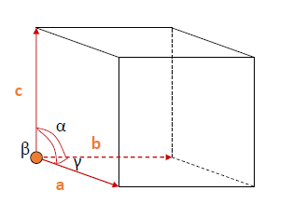
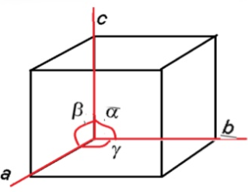
CRYSTALLOGRAPHIC AXES

Slide 17
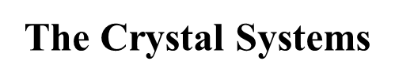
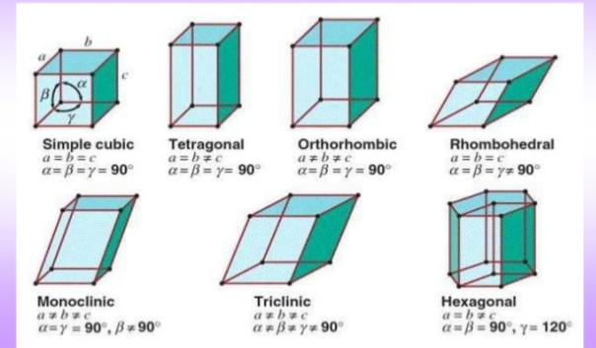

Slide 18
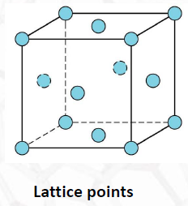
Bravais Lattices
By means of unit cells we managed to reduce all possible crystal structures to a relatively small numbers of basic unit cell geometries.
Now let us consider the issue how atoms (viewed as hard spheres ) can be stacked together within a given unit cell.
Lattice points are theoretical points arranged periodically in 3-D space, rather than actual atoms.
There is a limited number of possibilities, referred to as Bravais lattice.

Slide 19
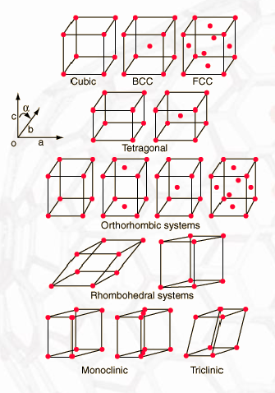
The 14 Bravais Lattices
Where Can I Put the Lattice Points?
The French scientist August Bravais, demonstrated in 1850 that only these 14 types of unit cells are compatible with the orderly arrangements of atoms found in crystals.
These three-dimensional configurations of points used to describe the orderly arrangement of atoms in a crystal.
Each point represents one or more atoms in the actual crystal, and if the points are connected by lines, a crystal lattice is formed.

Slide 20
Crystal Structure
In crystallography, crystal structure is a description of the ordered arrangement of atoms, ions or molecules in a crystalline material.
Metallic Crystals
It tend to be densely packed.
have several reasons for dense packing:
-Typically, only one element is present, so all atomic radii are the same.
-Metallic bonding is not directional.
-Nearest neighbor distances tend to be small in order to lower bond energy.
These metallic crystals have the simplest crystal structures. We will look at three such structures...

Slide 21
Cubic Unit Cells
SIMPLE CUBIC STRUCTURE (SC)
BODY CENTERED CUBIC STRUCTURE (BCC)
FACE CENTERED CUBIC STRUCTURE (FCC)

Slide 22
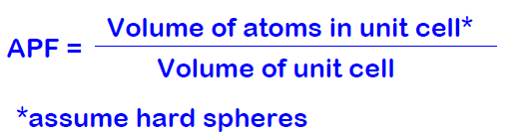
Coordination number
It is define as the number of nearest neighbors in the unit cell.
Atomic Packing Factor (APF)
It can be defined as the ratio between the volume of the basic atoms of the unit cell (which represent the volume of all atoms in one unit cell ) to the volume of the unit cell it self.
For cubic crystals, A.P. F its depends on the radius of atoms and characterization of chemical bonding.

Slide 23
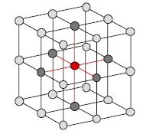
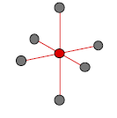
Simple Cubic (SC) Structure
This structure is rare due to poor packing(only Polonium has this structure).
Close-packed directions are cube edges.
Coordination number = 6

Slide 24
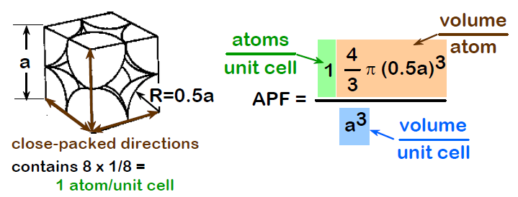
Atomic Packing Factor for Simple Cubic
APF for a simple cubic structure = 0.52

Slide 25
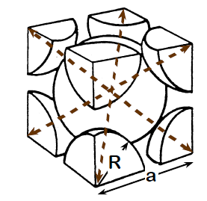
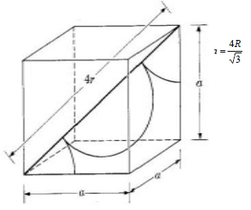
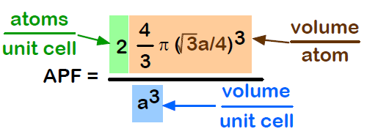
Body Centered Cubic Structure (BCC)
Close packed directions are cube diagonals.
Coordination number = 8
Close-packed directions: length = 4R = $\sqrt{3}$a
Unit cell contains: 1 + 8 x 1/8 = 2 atoms/unit cell
APF for a body-centered cubic structure = 0.68

Slide 26
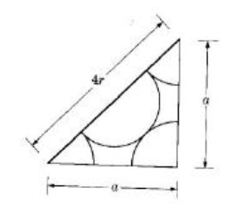
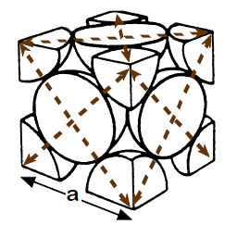
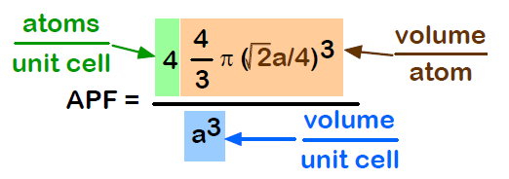
Face Centered Cubic Structure (FCC)
Close packed directions are face diagonals.
Coordination number = 12
Close-packed direction length = 4R = $\sqrt{2}$a
Unit cell contains: 6 x 1/2 + 8 x 1/8 = 4 atoms/unit cell
APF for a face-centered cubic structure = 0.74

Slide 27
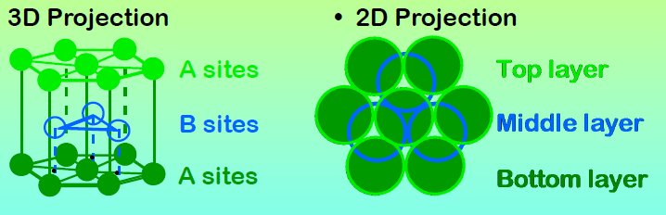
Hexagonal Close-Packed (HCP) Structure
Coordination number = 12
Close-packed direction length = 2R = a
Unit cell contains: 2 x 1/2 + 3 + (6 x 2) x 1/6 = 6 atoms/unit cell
ABAB... Stacking Sequence

Slide 28
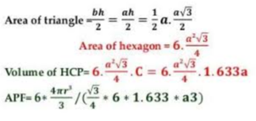

HCP crystal structure contains 6 atoms per unit cell.
C= 1.633 a
A=2r
Volume of HCP unit cell = Area of the hexagonal face x height of the hexagon.
Area of the hexagonal face= area of each triangle x 6
APF for a HCP crystal structure = 0.74

Slide 29
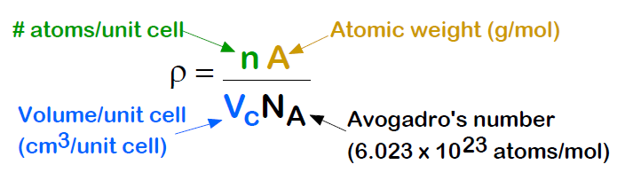
Theoretical Density (ρ)

Slide 30
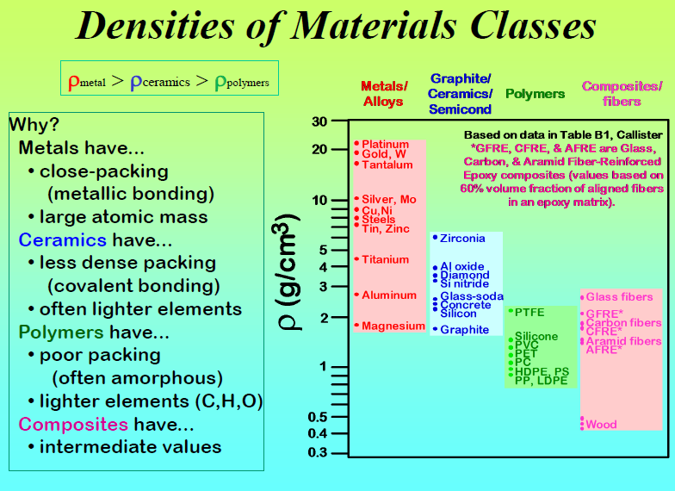

Slide 31
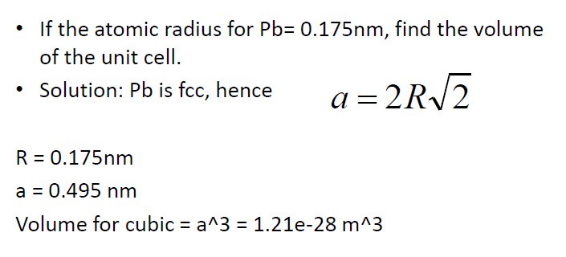
Problem 1

Slide 32
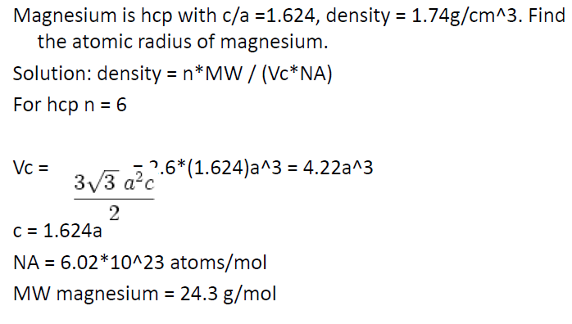
Problem 2

Slide 33
Crystal Imperfection or defects
Any deviation from the perfect atomic arrangement in a crystal is said to contain imperfections or defects.
A crystalline defect is a lattice irregularity having one or more of its dimensions on the order of an atomic dimension.
A perfect crystal, with every atom of the same type in the correct position, does not exist. There always exist crystalline defects. There are 4 major categories of crystalline defects:
Zero dimensional: Point defects occurring at a single lattice point.
One dimensional: Linear defects (dislocations) occurring along a row of atoms.
Two dimensional: Planar (surface) defects occurring over a two-dimensional surface in the crystal.
Three dimensional: Volume (bulk or void) defects

Slide 34
Crystal imperfections have strong influence upon many properties of crystals, such as strength, electrical conductivity and hysteresis loss of ferromagnetism.
Adding alloying elements to a metal is one way of introducing a crystal defect. Thus some important properties of crystals are controlled by as much as by imperfections and by the nature of the host crystals.
The conductivity of some semiconductors is due to entirely trace amount of chemical impurities.
Color, luminescence of many crystals arise from impurities and imperfections
Atomic diffusion may be accelerated enormously by impurities or imperfections
Mechanical and plastic properties are usually controlled by imperfections.

Slide 35
Crystal Defects Classification
For ease of their characterization, defects are classified on the basis of their geometry, which is realistic as defects are disrupted region in a volume of a solid.
1. Point defects:
a. Vacancy
b. Interstitial atom or interstitialcy
c. Schottky
d. Frenkel
2. Line defects
a. Edge dislocation
b. Screw dislocation
3. Surface defects
a. Grain boundaries
b. Tilt boundaries
c. Twin boundaries
d. Stacking faults
4. Volume defects
a. Inclusions
b. Voids

Slide 36
1. Point defects
Point defects, are imperfect point-like regions in the crystal, where an atom is missing or is in an irregular place in the lattice structure.
Typical size of a point defect is about 1-2 atomic diameters.
Vacancy
A vacancy is a vacant lattice position from where the atom is missing. It is usually
created when the solid is formed by cooling the liquid.
There are other ways of making a vacancy, but they also occur naturally as a result of thermal excitation, and these are thermodynamically stable at temperatures greater than zero.

Slide 37

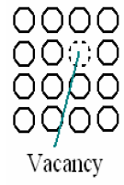
At equilibrium, the fraction of lattice sites that are vacant at a given temperature (T) are:
where n is the number of vacant sites in N lattice positions,
k is gas or Boltzmann’s constant,
T is absolute temperature in kelvins, and
Q is the energy required to move an atom from the interior of a crystal to its surface.
It is clear from the equation that there is an exponential increase in number of vacancies with temperature.
When the density of vacancies becomes relatively large, there is a possibility for them to cluster together and form voids.

Slide 38
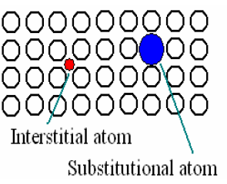
b. Interstitialcy
An interstitial atom or interstitialcy is an atom that occupies a place outside the normal lattice position.
It may be the same type of atom as the rest surrounding it (self interstitial) or a foreign impurity atom. Interstitialcy is most probable if the atomic packing factor is low.
Another way an impurity atom can be fitted into a crystal lattice is by substitution. A substitutional atom is a foreign atom occupying original lattice position by displacing the parent atom.
In the case of vacancies and foreign atoms (both interstitial and substitutional), there is a change in the coordination of atoms around the defect. This means that the forces are not balanced in the same way as for other atoms in the solid, which results in lattice distortion around the defect.

Slide 39
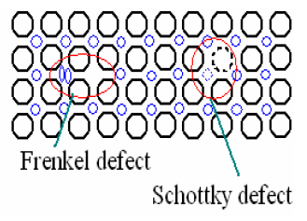
Frenkel and Schottky defects
In ionic crystals, existence of point defects is subjected to the condition of charge neutrality. There are two possibilities for point defects in ionic solids.

Slide 40
when an ion displaced from a regular position to an interstitial position creating a vacancy, the pair of vacancy-interstitial is called Frenkel defect. Cations are usually smaller and thus displaced easily than anions. Closed packed structures have fewer interstitials and displaced ions than vacancies because additional energy is required to force the atoms into the interstitial positions.
A pair of one cation and one anion can be missing from an ionic crystal, without violating the condition of charge neutrality when the valency of ions is equal. The pair of vacant sites, thus formed, is called Schottky defect. This type of point defect is dominant in alkali halides. These ion-pair vacancies, like single vacancies, facilitate atomic diffusion.

Slide 41
2. Line defects or Dislocations
In linear defects groups of atoms are in irregular positions. Linear defects are commonly called dislocations. Any deviation from perfectly periodic arrangement of atoms along a line is called the line imperfection.
A line defect is a lattice distortion created about a line formed by the solidification process, plastic deformation, vacancy condensation or atomic mismatch in solid solutions.
The line imperfection acting as boundary between the slipped and un-slipped region, lies in the slip plane and is called a dislocation.
Dislocations are generated and move when a stress is applied. The strength and ductility of metals are controlled by dislocations. They are characterized by the Burgers vector (b), whose direction and magnitude can be determined by constructing a loop around the disrupted region and noticing the extra inter-atomic spacing needed to close the loop.

Slide 42
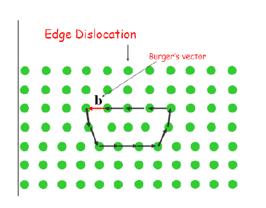
Two types of dislocations are distinguish as
1. Edge dislocations and
2. Screw dislocations.
Edge dislocation or Taylor-Orowan dislocation
It is characterized by a Burger’s vector that is perpendicular to the dislocation line.
It may be described as an edge of an extra plane of atoms within a crystal structure. Thus regions of compression and tension are associated with an edge dislocation. Because of extra incomplete plane of atoms, the atoms above the dislocation line are squeezed together and are in state of compression whereas atoms below are pulled apart and experience tensile stresses.

Slide 43
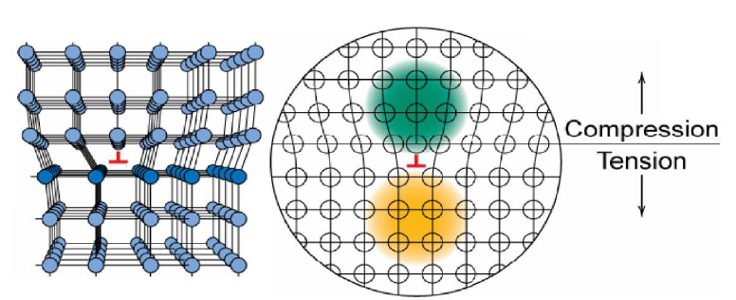
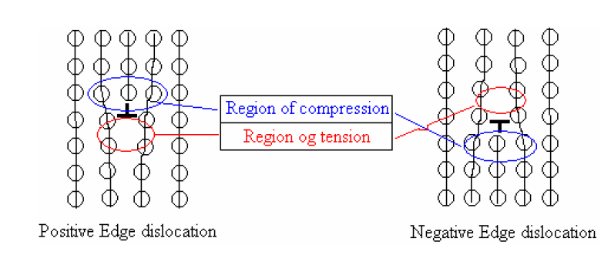
Edge dislocation is considered positive when compressive stresses present above the dislocation line, and is represented by ┴.
If the stress state is opposite i.e. compressive stresses exist below the dislocation line, it is considered as negative edge dislocation, and represented by ┬. A schematic view of edge dislocations are shown ahead.
Edge dislocations

Slide 44
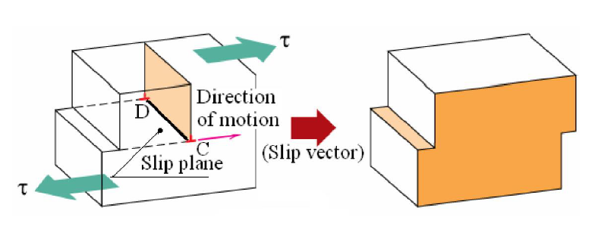
Dislocation moves along slip plane in slip direction perpendicular to dislocation line CD. A pure edge dislocation can glide or slip in a direction perpendicular to its length. It may move vertically by a process known as climb, if diffusion of atoms or vacancies can take place.

Slide 45
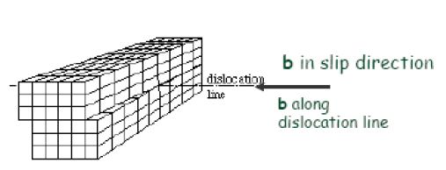
2. Screw or Burgers dislocation
Screw dislocation or Burgers dislocation has its dislocation line parallel to the Burger’s vector.
A screw dislocation is like a spiral ramp with an imperfection line down its axis.
Screw dislocations result when displacing planes relative to each other through shear.
Shear stresses are associated with the atoms adjacent to the screw dislocation; therefore extra energy is involved as it is in the case of edge dislocations.

Slide 46
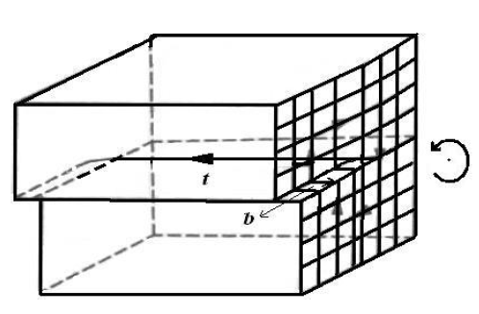
Screw dislocation is considered positive if Burger’s vector and t-vector or parallel, and vice versa. (t-vector – an unit vector representing the direction of the dislocation line).
A positive screw dislocation is represented by
a dot surrounded by circular direction in clock-wise direction”,
whereas the negative screw dislocation is represented by a dot surrounded by a circular direction in anti-clock-wise direction”.
Negative screw dislocation

Slide 47
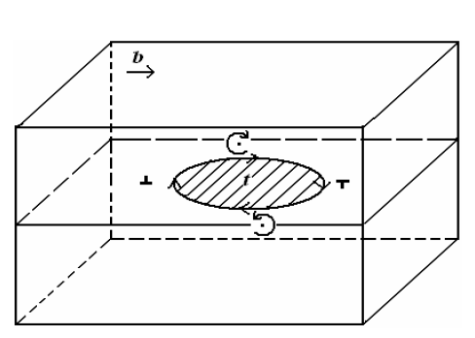
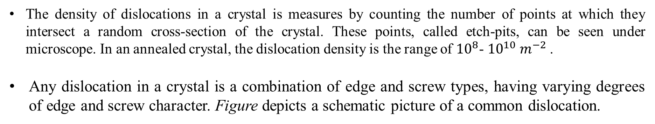
The density of dislocations in a crystal is measures by counting the number of points at which they intersect a random cross-section of the crystal. These points, called etch-pits, can be seen under microscope. In an annealed crystal, the dislocation density is the range of ${10}^{8}$- ${10}^{10} m^{−2}$.
Any dislocation in a crystal is a combination of edge and screw types, having varying degrees of edge and screw character. Figure depicts a schematic picture of a common dislocation.
Typical dislocation in a crystal.

Slide 48
3. Surface defects
These defects can be defined as boundaries that have two dimensional imperfections in crystalline solids, and have different crystal structures and/or crystallographic orientations on either side of them. They refer to the regions of distortions that lie about a surface having thickness of a few atomic diameters.
These imperfections are not thermodynamically stable, rather they are meta-stable imperfections. They arise from the clustering of line defects into a plane.

Slide 49
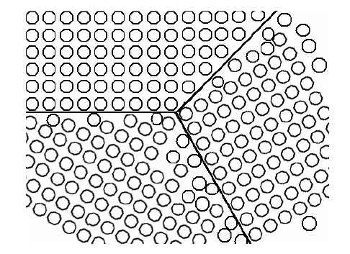
a. Grain boundaries
Crystalline solids are, usually, made of number of grains separated by grain boundaries. Grain boundaries are several atoms distances wide, and there is mismatch of orientation of grains on either side of the boundary as shown in figure.
When this misalignment is slight, on the order of few degrees (< 10°), it is called low angle grain boundary. These boundaries can be described in terms of aligned dislocation arrays.
Schematic presentation of grain boundaries

Slide 50
Tilt boundaries
If the low grain boundary is formed by edge dislocations, it is called tilt boundary, and
twist boundary if formed of screw dislocations.
Both tilt and twist boundaries are planar surface imperfections in contrast to high angle grain boundaries.
For high angle grain boundaries, degree of disorientation is of large range (> 15°).
Grain boundaries are chemically more reactive because of grain boundary energy. In spite of disordered orientation of atoms at grain boundaries, polycrystalline solids are still very strong as cohesive forces present within and across the boundary.

Slide 51
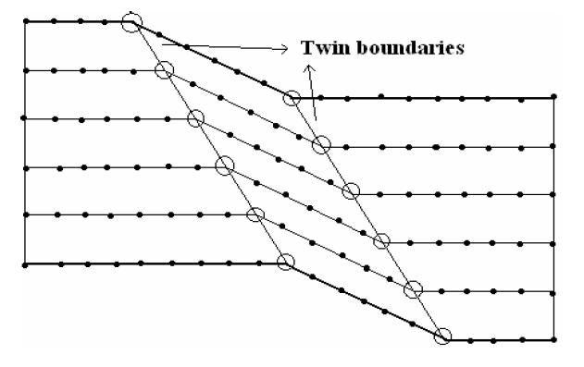
Twin boundaries
It is a special type of grain boundary across which there is specific mirror lattice symmetry. Twin boundaries occur in pairs such that the orientation change introduced by one boundary is restored by the other (figure).
The region between the pair of boundaries is called the twinned region.
Twins which forms during the process of recrystallization are called annealing twins, whereas deformation twins form during plastic deformation.
Annealing twins are typically found in metals that have FCC crystal structure (and low stacking fault energy), while mechanical/deformation twins are observed in BCC and HCP metals.

Slide 52
Stacking faults
They are faults in stacking sequence of atom planes. Stacking sequence in an FCC crystal is ABC ABC ABC …, and the sequence for HCP crystals is AB AB AB…. When there is disturbance in the stacking sequence, formation of stacking faults takes place.
Two kinds of stacking faults in FCC crystals are:
(a) ABC AC ABC…where CA CA represent thin HCP region which is nothing but stacking fault in FCC,
(b) ABC ACB CABC is called extrinsic or twin stacking fault.
Three layers ACB constitute the twin. Thus stacking faults in FCC crystal can also be considered as submicroscopic twins.
Stacking fault energy varies in range 0.01-0.1 J/m2.
Lower the stacking fault energy, wider the stacking fault, metal strain hardens rapidly and twin easily. Otherwise, metals of high stacking fault energy i.e. narrower stacking faults show a deformation structure of banded, linear arrays of dislocations.

Slide 53
Bulk or Volume defects
Volume defects as name suggests are defects in 3-dimensions.
These include pores, cracks, foreign inclusions and other phases.
These defects are normally introduced during processing and fabrication steps. All these defects are capable of acting as stress raisers, and thus deleterious to parent metal’s mechanical behavior.
However, in some cases foreign particles are added purposefully to strengthen the parent material. The procedure is called dispersion hardening where foreign particles act as obstacles to movement of dislocations, which facilitates plastic deformation.
The second-phase particles act in two distinct ways
- particles are either may be cut by the dislocations or
- the particles resist cutting and dislocations are forced to bypass them.
Strengthening due to ordered particles is responsible for the good high-temperature strength on many super-alloys.
However, pores are detrimental because they reduce effective load bearing area and act as stress concentration sites.

Slide 54
FUNDAMENTALS OF DIFFRACTION
A beam of X-rays consists of a bundle of separate waves, the waves can interact with one another. Such interaction is termed interference.
If all the waves in the bundle are in phase, that is their crests and troughs occur at exactly the same position (the same as being an integer number of wavelengths out of phase, nλ, n = 1, 2, 3, 4, etc.), the waves will interfere with one another and their amplitudes will add together to produce a resultant wave that is has a higher amplitude (the sum of all the waves that are in phase. )

Slide 55
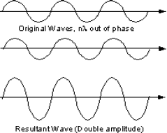
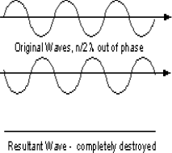
If the waves are out of phase, being off by a non-integer number of wavelengths, then destructive interference will occur, and the amplitude of the waves will be reduced.
In an extreme case, if the waves are out of phase by an odd multiple of ½ λ [(2n+1)/2λ ], the resultant wave will have no amplitude and thus be completely destroyed.

Slide 56
BRAGG’S LAW
Two such X-rays are shown here, where the spacing between the atomic planes occurs over the distance, d.
Ray 1 reflects off of the upper atomic plane at an angle θ equal to its angle of incidence. Similarly, Ray 2 reflects off the lower atomic plane at the same angle θ. While Ray 2 is in the crystal, however, it travels a distance of 2a farther than Ray 1.

Slide 57
If this distance 2a is equal to an integral number of wavelengths (nλ), then Rays 1 and 2 will be in phase on their exit from the crystal and constructive interference will occur. If not destructive interference will occur and the waves will not be as strong as when they entered the crystal. Two such X-rays are shown here, where the spacing between the atomic planes occurs over the distance, d.
Ray 1 reflects off of the upper atomic plane at an angle θ equal to its angle of incidence. Similarly, Ray 2 reflects off the lower atomic plane at the same angle θ. While Ray 2 is in the crystal, however, it travels a distance of 2a farther than Ray 1. If this distance 2a is equal to an integral number of wavelengths (nλ), then Rays 1 and 2 will be in phase on their exit from the crystal and constructive interference will occur. If not destructive interference will occur and the waves will not be as strong as when they entered the crystal.

Slide 58
Condition for constructive interference to occur is
nλ = 2a
but, from trigonometry, we can figure out what the distance 2a is in terms of the spacing, d, between the atomic planes.
a = d sin θ
or 2a = 2 d sin θ
thus, nλ = 2d sin θ
This is known as Bragg's Law for X-ray diffraction.

Slide 59
X RAY CRYSTALLOGRAPHY
X-ray crystallography is a method of determining the arrangement of atoms within a crystal, in which a beam of X-rays strikes a crystal and causes the beam of light to spread into many specific directions.
From the angles and intensities of these diffracted beams, a crystallographer can produce a three-dimensional picture of the density of electrons within the crystal.
Because X-rays have wavelengths similar to the size of atoms, they are useful to explore within crystals.

Slide 60
USES
Used to study many materials which form crystals like salts, metals, minerals, semiconductors, as well as various inorganic, organic and biological molecules.
Determine electron density, the mean positions of the atoms in the crystal their chemical bonds, their disorder and various other information.
Size of atoms, the lengths and types of chemical bonds, and the atomic-scale differences among various materials, especially minerals and alloys. The method also revealed the structure and function of many biological molecules, including vitamins, drugs, proteins and nucleic acids such as DNA.
Characterizing the atomic structure of new materials and in discerning materials that appear similar by other experiments.
X-ray crystal structures can also account for unusual electronic or elastic properties of a material, shed light on chemical interactions and processes, or serve as the basis for designing pharmaceuticals against diseases.

Slide 61
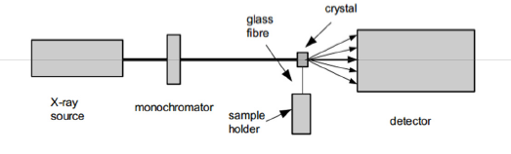
X-RAY DIFFRACTION
X-Ray Crystallography uses the uniformity of light diffraction of crystals to determine the structure of a molecule or atom.
Then they use an X-ray beam to “hit” the crystallized molecule. The electrons surrounding the molecule diffract as the X-rays hit them. This forms a pattern, this type of pattern is called the X-ray diffraction pattern.

Slide 62
LIMITATIONS
Two limiting cases of X-ray crystallography.
Small-molecule crystallography typically involves crystals with fewer than 100 atoms in their asymmetric unit; such crystal structures are usually so well resolved that the atoms can be discerned as isolated "blobs" of electron density.
By contrast, macromolecular crystallography often involves tens of thousands of atoms in the unit cell. Such crystal structures are generally less well-resolved (more "smeared out"); the atoms and chemical bonds appear as tubes of electron density, rather than as isolated atoms.
In general, small molecules are also easier to crystallize than macromolecules; however, X-ray crystallography has proven possible even for viruses with hundreds of thousands of atoms.

Slide 63
Miller Indices
Miller Indices are used to refer to specific lattice planes of atoms.
These directions and planes could be in lattices or in crystals.
These are reciprocals of the fractional intercepts (with fractions cleared) that the plane makes with the crystallographic x, y and z axes of three nonparallel edges of the cubic unit cell.
The number of indices will match with the dimension of the lattice or the crystal.
E.g. in 1D there will be 1 index and 2D there will be two indices etc.

Slide 64
Importance of Miller Indices
In Materials Science it is important to have a notation system for atomic planes since these planes influence
Optical properties
Reactivity
Surface tension
Dislocations

Slide 65
Notation Summary
•(h,k,l) represents a point – note the exclusive use of commas
Negative numbers/directions are denoted with a bar on top of the number
[hkl] represents a direction
<hkl> represents a family of directions
(hkl) represents a plane
{hkl} represents a family of planes

Slide 66
Miller Indices for Planes: Procedure
Choose a plane that does not pass through origin
Step 1: Identify the plane intercepts on the x, y and z-axes.
Step 2: Specify intercepts in fractional coordinates.
Step 3: Take the reciprocals of the fractional intercepts.
Step 4: Fractions?
a. If Yes, Clear fractions by multiplying by an integer to determine smallest set of whole numbers, then go to b
b. If No, Place a “bar” over the Negative indices
Step 5: Enclose in parenthesis (hkl) where h,k,l are miller indices of cubic crystal plane for x, y and z axes.
Note: if the one of axis value was negative then move the center of cubic to negative value direction .

Slide 67
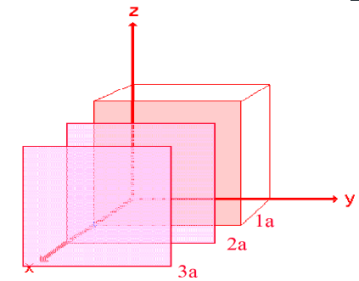
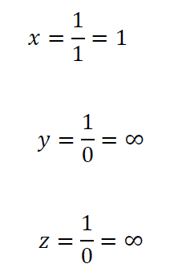
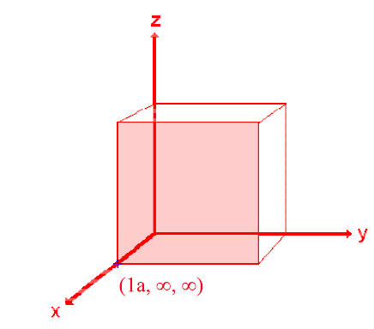
Miller Indices for Planes: Illustration
Consider the plane in pink, which is one of an infinite number of parallel plane each a consistent distance (“a”) away from the origin (purple planes)
The plane intersects the x-axis at point a. It runs parallel along y and z axes.
Thus, this plane can be designated as (1,∞,∞).

Slide 68

Likewise, the yellow plane can be designated as (∞,1,∞).
And the green plane can be written as (∞,∞,1).
Miller Indices are the reciprocals of the parameters of each crystal face.
Thus:
Pink Face
= (1/1, 1/∞, 1/∞) = (100)
Green Face
= (1/∞, 1/∞, 1/1) = (001)
Yellow Face
= (1/∞, 1/1, 1/∞) = (010)

